Slide 1




MASTER PROGRAM IN
DATA SCIENCE AI & MACHINE LEARNING
www.mcta.co.in

Slide 2



Artificial Neural Networks
www.mcta.co.in
www.mcta.co.in

Slide 3
Contents covered
Artificial neural network using sklearn packages
MLP Regressor
MLP Classifier
2) Artificial neural network using Tensorflow, Keras
Concepts like Neurons, Weights, bias, Forward Propogation, Backward Propogation, Optimizers, Activation Functions
Tensorflow :- Introduction to Tensorflow packages
Keras :- Basics of Keras packages
3) Convolutional neural networks
CNN intro :- Terms and terminologies, technical aspects, maths behind the algo
CNN using eras :- Handwritten Digit recognition - Deep NN
4) Recurrent Neural networks and LSTM
www.mcta.co.in

Slide 4
Contents covered
4) Recurrent Neural networks
RNN :- Introduction to RNN, Sequence prediction using RNN
LSTM :- Introduction to LSTM, Sequence prediction using LSTM
www.mcta.co.in

Slide 5
Artificial neural network (Introduction and Basics)
MLP - Multi Layer Perceptron
The most popular machine learning library for Python is SciKit Learn. We will learn how Neural Networks work and how to implement them with the Python programming language and latest version of SciKit-Learn
Neural Networks
Neural Networks are a machine learning framework that attempts to mimic the learning pattern of natural biological neural networks. Biological neural networks have interconnected neurons with dendrites that receive inputs, then based on these inputs they produce an output signal through an axon to another neuron. We will try to mimic this process through the use of Artificial Neural Networks (ANN), which we will just refer to as neural networks from now on. The process of creating a neural network begins with the most basic form, a single perceptron.
www.mcta.co.in

Slide 6
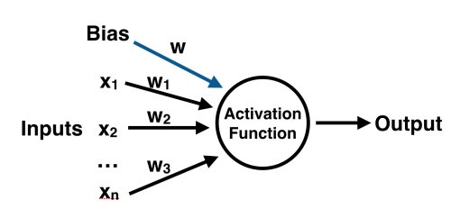
Artificial neural network using sklearn packages
Artificial neural network (Introduction and Basics)
The Perceptron
A perceptron has one or more inputs, a bias, an activation function, and a single output. The perceptron receives inputs, multiplies them by some weight, and then passes them into an activation function to produce an output. There are many possible activation functions to choose from, such as the logistic function, a trigonometric function, a step function etc. We also make sure to add a bias to the perceptron, this avoids issues where all inputs could be equal to zero (meaning no multiplicative weight would have an effect). Check out the diagram below for a visualization of a perceptron:
www.mcta.co.in

Slide 7
Artificial neural network using sklearn packages
Artificial neural network (Introduction and Basics)
The Perceptron - weights, bias
What are weights and bias:-
In order to understand what does the ‘weight matrix’ mean in terms of neural networks, you need to first understand the working of a single neuron, or better still, a Perceptron.
First of all, what is a Perceptron ? A Perceptron is a type of artificial neuron which takes in several binary inputs x1, x2, … , xn and produces a single binary output. In the example shown above, there are three inputs x1, x2 and x3.
In order to compute an output, here’s what you could do (O = Output):
a) Sum up the inputs. O = x1 + x2 + x3
b) Apply a linear mathematical operation
to the inputs. O = (x1 * x2) + x3
www.mcta.co.in

Slide 8
Artificial neural network using sklearn packages
Artificial neural network (Introduction and Basics)
To understand the best possible approach to this problem, we need to realize that since x1,x2 and x3 are binary inputs here, multiplying one or more inputs together can result in a 0 output if one of the inputs is 0. So, this tells us that approach (b) can have its output as O = x3, if x1 or x2 or both are equal to zero. If only one of them is equal to 0, this can lead to a loss of information as the input value gets multiplied by 0.
Now, let us see the simple approach (a), understand why it’s partially correct and what we can do to make it fully correct. Approach (a) sure takes into account all the inputs without one being immediately affected by the other. However, it does not take in the relative importance of the inputs.
Let me explain what that means.
Consider a simple example where you want to make a perceptron for predicting whether it will rain today or not. You have a binary output as O, which can take values of 0 or 1 and inputs x1 and x2.
Let x1 be 1 if the weather is humid today, 0 if the opposite. Let x2 be 1 if you are wearing a red shirt today and 0 if not. We can see here that wearing a red shirt has almost no correlation with the possibility of rainfall. So, a possible output function can be:
O = x1 + 0.1 * x2
Here’s what the factor 0.1 does. If x2 is 0, 0.1*x2 is still 0, but if x2 is 1, 0.1*x2 will be 0.1, not 1. It basically brings down the importance of the input x2 from 1 to 0.1, and hence, it is called the ‘weight’ of the input x2.
Consider x2 to be 1 for now. O will still be (0 + 0.1) = 0.1 or (1 + 0.1) = 1.1, i.e. not a binary value. In order to make it one, what we can do is use a ‘threshold’ for the total value of O. We can say, like, O is 1 if (x1 + 0.1 * x2) > 1 and O = 0 if (x1 + 0.1 * x2) < 1. We have thus solved our problem.
www.mcta.co.in

Slide 9


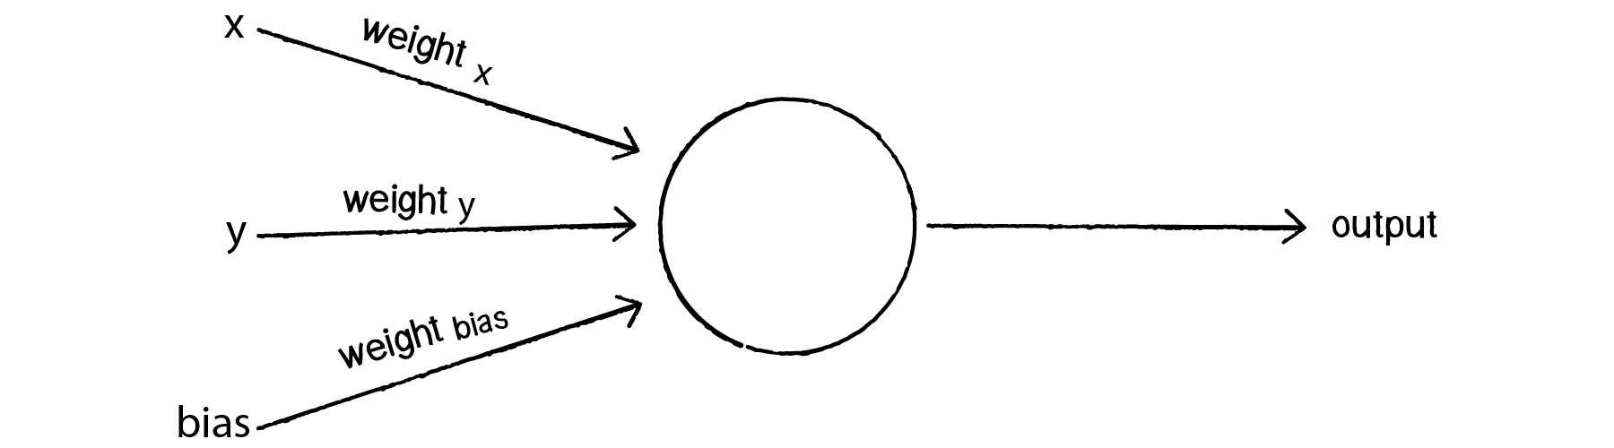
Artificial neural network using sklearn packages
Artificial neural network (Introduction and Basics)
So basically
And now making some final notational simplifications, we say
b is commonly known as bias.
Note: ‘T’ is the transpose operation. And w.x is matrix multiplication.
And now you can apply this understanding to a sigmoid neuron, or whole artificial neural networks.
Where
Output = 1 if {x * (weight of x) + y * (weight of y) + b} > 0,
Output = 0, otherwise
www.mcta.co.in

Slide 10
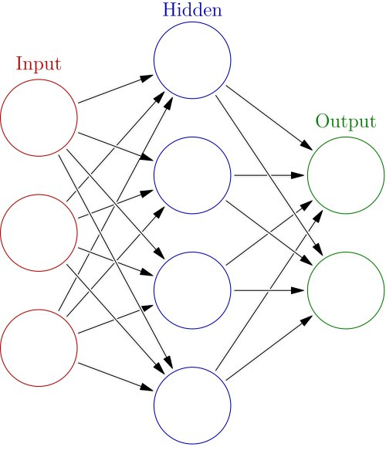
Artificial neural network using sklearn packages
Artificial neural network (Introduction and Basics)
Once we have the output we can compare it to a known label and adjust the weights accordingly (the weights usually start off with random initialization values). We keep repeating this process until we have reached a maximum number of allowed iterations, or an acceptable error rate.
To create a neural network, we simply begin to add layers of perceptrons together, creating a multi-layer perceptron model of a neural network. You'll have an input layer which directly takes in your feature inputs and an output layer which will create the resulting outputs. Any layers in between are known as hidden layers because they don't directly "see" the feature inputs or outputs
Check mlp_classifier.ipynb for python implodention for
Classification example and mlp_regressor.ipynb for Regression example
www.mcta.co.in

Slide 11
Artificial neural network using sklearn packages
Artificial neural network (Introduction and Basics)
Data Preprocessing
The neural network may have difficulty converging before the maximum number of iterations allowed if the data is not normalized. Multi-layer Perceptron is sensitive to feature scaling, so it is highly recommended to scale your data. Note that you must apply the same scaling to the test set for meaningful results. There are a lot of different methods for normalization of data, we will use the built-in StandardScaler for standardization.
Training the model
SciKit Learn makes this incredibly easy, by using estimator objects. In this case we will import our estimator (the Multi-Layer Perceptron Classifier model for classification problems and Multi-Layer Perceptron Regressor model for regression problems) from the neural_network library of SciKit-Learn!
However in practice there are various advanced libraries like tensorflow, keras, pythorch etc that are widely used
To begin with lets solve some classical problems with sklearns MLP classifier, post that we shall deep dive into keras and tensorflow
www.mcta.co.in

Slide 12
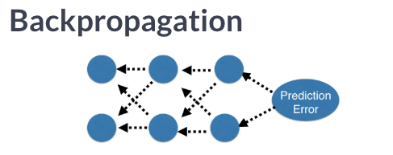
Artificial neural network using sklearn packages
Artificial neural network (Forward and back propagation)
Forward propagation and backward propagation
What is Forward propagation :-
As we saw in the multi layer perceptron model about how values are passed from input layer to the hidden layer(layers) then to the output layer, this process is known as forward propagation
Its the process where data is received from input layer, multiplied with its respective weights, added with bias and passed to the next layers that repeats the same procedure until it reaches the output layer
What is Back propagation :-
Back propagation is done as a step to optimise the models accuracy, hence this step comes after the forward propagation.
Step 1 - calculate the error (actual - predicted)
Step 2 - adjust the weights in small steps
(determined by the learning rate)
Step 3 - Rerun forward propagation
Step4 - repeat from Step 1 to Step 3 until an optimal accuracy is
reached
www.mcta.co.in

Slide 13
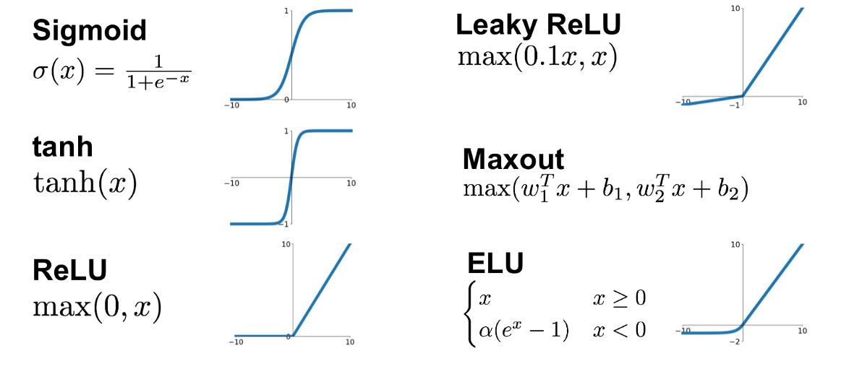
Artificial neural network using sklearn packages
Artificial neural network (Activation functions)
What are activation function :-
Activation functions are mathematical formulas that are applied to the values in each neuron before its passed to the next neutron
Below is the representation of each of those activation functions
However, in practice we widely use RELU
And - Sigmoid if its a binary classifier
www.mcta.co.in

Slide 14
Artificial neural network using sklearn packages
Artificial neural network (Keras and Tensorflow)
Tensorflow -
A couple of years ago, deep learning started to outperform all other machine learning algorithms when giving a massive amount of data. Google saw it could use these deep neural networks to improve its services:
Gmail
Photo
Google search engine
They build a framework called Tensorflow to let researchers and developers work together on an AI model. Once developed and scaled, it allows lots of people to use it.
It was first made public in late 2015, while the first stable version appeared in 2017. It is open source under Apache Open Source license. You can use it, modify it and redistribute the modified version for a fee without paying anything to Google.
TensorFlow Architecture - Tensorflow architecture works in three parts:
1- Preprocessing the data
2- Build the model
3 -Train and estimate the model
It is called Tensorflow because it takes input as a multi-dimensional array, also known as tensors. You can construct a sort of flowchart of operations (called a Graph) that you want to perform on that input. The input goes in at one end, and then it flows through this system of multiple operations and comes out the other end as output.
This is why it is called TensorFlow because the tensor goes in it flows through a list of operations, and then it comes out the other side.
www.mcta.co.in

Slide 15
Artificial neural network using sklearn packages
Artificial neural network (Keras and Tensorflow)
Keras Library -
Keras is one of the leading high-level neural networks APIs. It is written in Python and supports multiple back-end neural network computation engines.
It uses tensorflow as its backend but is also capable of running on other libraries like theano
Keras does not do its own low-level operations, such as tensor products and convolutions; it relies on a back-end engine for that. Even though Keras supports multiple back-end engines, its primary (and default) back end is TensorFlow, and its primary supporter is Google. The Keras API comes packaged in TensorFlow as tf.keras, which as mentioned earlier will become the primary TensorFlow API as of TensorFlow
check keras.ipynb for implementation
check tesorflow.ipynb for implementation
www.mcta.co.in

Slide 16
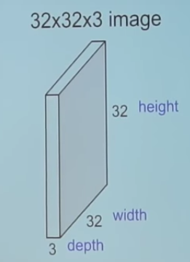
Artificial neural network using sklearn packages
Artificial neural network (CNN)
CNN - Convolutional Neural Network
CNNs have wide applications in image and video recognition, recommender systems and natural language processing. In this article, the example that I will take is related to Computer Vision. However, the basic concept remains the same and can be applied to any other use-case!
CNNs, like neural networks, are made up of neurons with learnable weights and biases. Each neuron receives several inputs, takes a weighted sum over them, pass it through an activation function and responds with an output. The whole network has a loss function and all the tips and tricks that we developed for neural networks still apply on CNNs
So, how are Convolutional Neural Networks different than Neural Networks?
CNNs operate over Volumes !
What do we mean by this?
Unlike neural networks, where the input is a vector, here the input is a multi-channeled image (3 channeled in this case).
There are other differences that we will talk about in a while.
Before we go any deeper, let us first understand what convolution means.
www.mcta.co.in

Slide 17
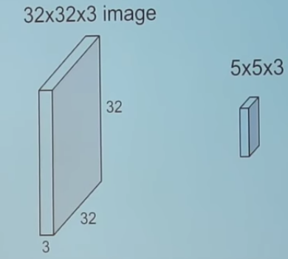
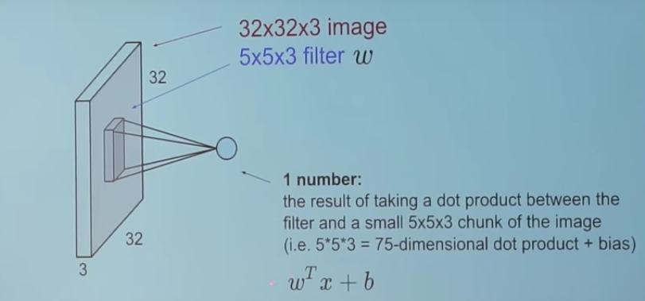
Artificial neural network using sklearn packages
Artificial neural network (CNN)
Convolution
We take the 5*5*3 filter and slide it over the complete image and
along the way take the dot product between the filter and chunks of the input image.
For every dot product taken, the result is a scalar.
So, what happens when we convolve the complete image with the filter?
www.mcta.co.in

Slide 18
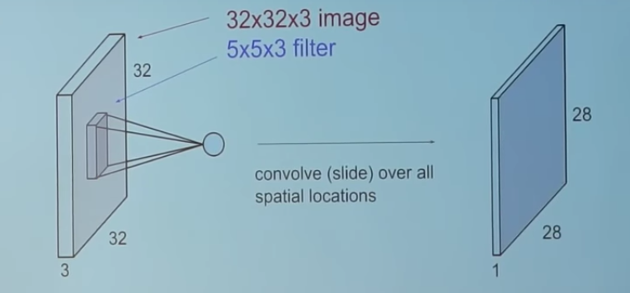
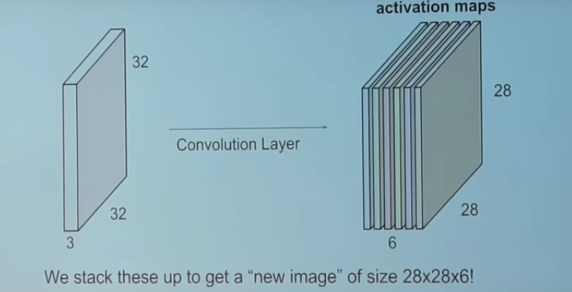
Artificial neural network using sklearn packages
Artificial neural network (CNN)
For every dot product taken, the result is a scalar.
So, what happens when we convolve the complete image with the filter?
The convolution layer is the main building
block of a convolutional neural network.
www.mcta.co.in

Slide 19
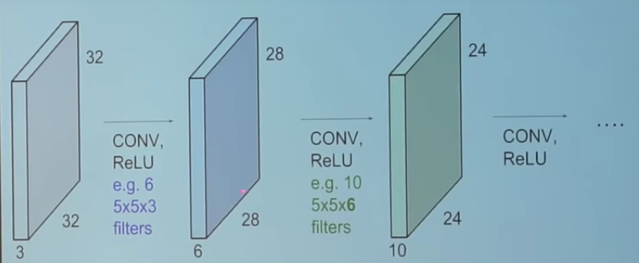
Artificial neural network using sklearn packages
Artificial neural network (CNN)
The convolution layer comprises of a set of independent filters (6 in the example shown). Each filter is independently convolved with the image and we end up with 6 feature maps of shape 28*28*1.
Suppose we have a number of convolution layers in sequence. What happens then?
All these filters are initialized randomly and become our parameters which will be learned by the network subsequently.
www.mcta.co.in

Slide 20
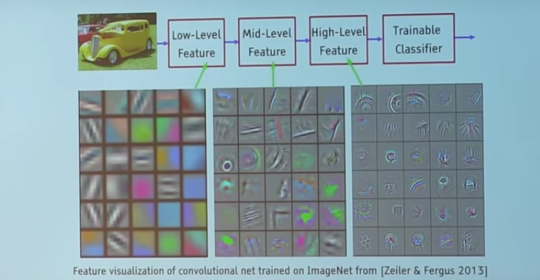
Artificial neural network using sklearn packages
Artificial neural network (CNN)
Lets see an example of a trained CNN
Take a look at the filters in the very first layer (these are our 5*5*3 filters). Through back propagation, they have tuned themselves to become blobs of coloured pieces and edges. As we go deeper to other convolution layers, the filters are doing dot products to the input of the previous convolution layers. So, they are taking the smaller coloured pieces or edges and making larger pieces out of them.
Take a look at image 4 and imagine the 28*28*1 grid as a grid of 28*28 neurons. For a particular feature map (the output received on convolving the image with a particular filter is called a feature map), each neuron is connected only to a small chunk of the input image and all the neurons have the same connection weights. So again coming back to the differences between CNN and a neural network.
www.mcta.co.in

Slide 21
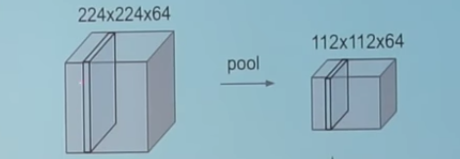
Artificial neural network using sklearn packages
Artificial neural network (CNN)
CNNs have a couple of concepts called parameter sharing and local connectivity
Parameter sharing is sharing of weights by all neurons in a particular feature map.
Local connectivity is the concept of each neural connected only to a subset of the input image (unlike a neural network where all the neurons are fully connected)
This helps to reduce the number of parameters in the whole system and makes the computation more efficient.
I will not be talking about the concept of zero padding here as the idea is to keep it simple. Interested people can read about it separately!
Pooling Layers
A pooling layer is another building block of a CNN.
Pooling
Its function is to progressively reduce the spatial size of the representation to reduce the amount of parameters and computation in the network. Pooling layer operates on each feature map independently.
www.mcta.co.in

Slide 22
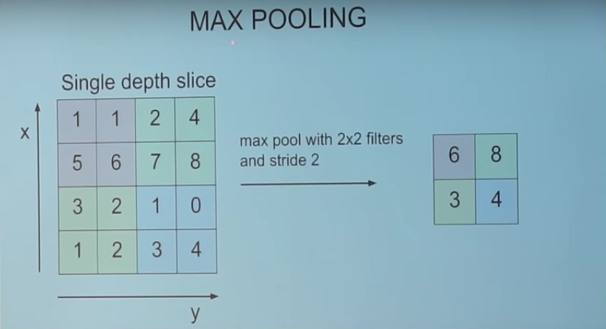
Artificial neural network using sklearn packages
Artificial neural network (CNN)
Pooling layers are the function is to progressively reduce the spatial size of the representation to reduce the amount of parameters and computation in the network. Pooling layer operates on each feature map independently.
The most common approach used in pooling is max pooling.
www.mcta.co.in

Slide 23
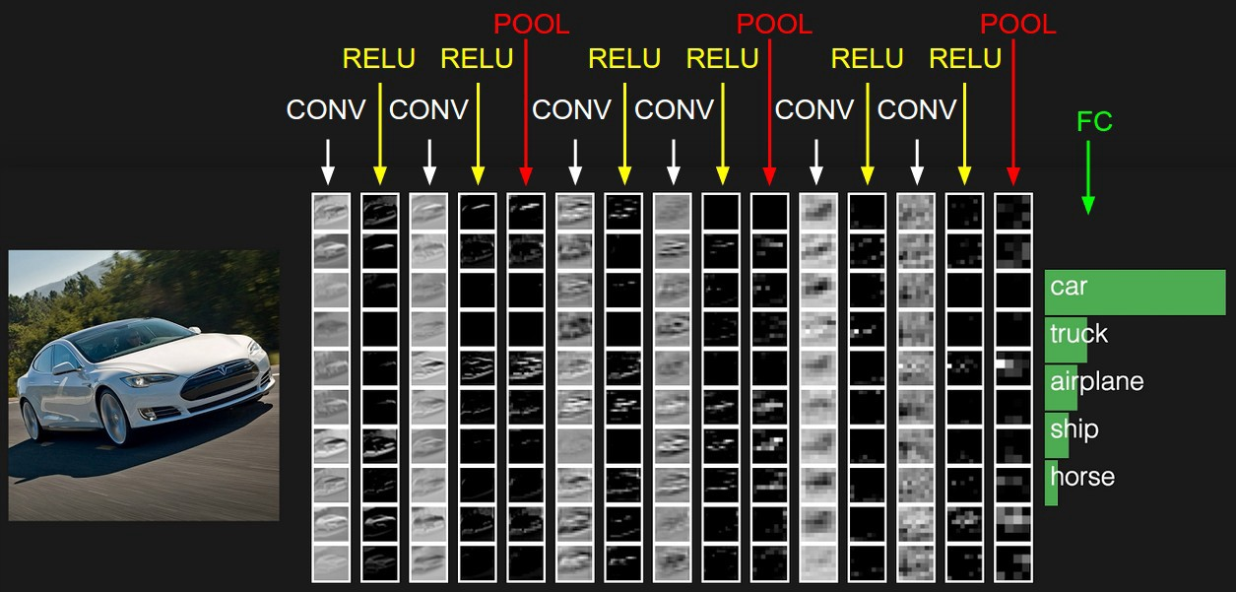
Artificial neural network using sklearn packages
Artificial neural network (CNN)
A typical architecture of a CNN
Check,
“hand written digit
recogniser.ipynb"
for python implementation
of CNN
We have already discussed about convolution layers (denoted by CONV) and pooling layers (denoted by POOL).
RELU is just a non linearity which is applied similar to neural networks.
The FC is the fully connected layer of neurons at the end of CNN. Neurons in a fully connected layer have full connections to all activations in the previous layer, as seen in regular Neural Networks and work in a similar way.
www.mcta.co.in

Slide 24
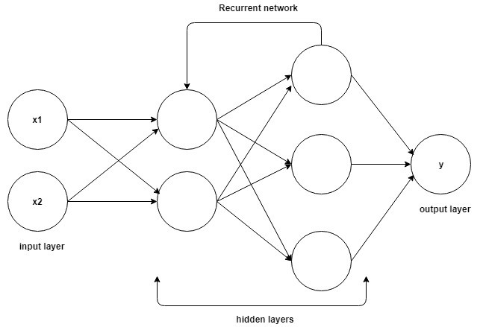
Artificial neural network using sklearn packages
Artificial neural network (RNN)
RNN - Recurrent Neural Network
Unlike feed-forward neural networks, recurrent neural networks have a backward connection between hidden layers. Therefore, they have some kind of memory in them. One can use RNN-s in different problems like: time series analysis, natural language processing and speech recognition. One of the most popular, modern RNN is called long short-term memory model (LSTM). One can construct a LSTM using Keras like we did to construct a eras model
Like we see in the Diagram,
Unlike CNN model, layers in RNN model
Receives input not only from its previous layers
but also from its next layer
This helps the model to understand patterns and
Relationship of a vector with each other
Thus domains like stock predictions, NLP etc are
heavily dependent on LSTM over the regular feed
forward neural network
Check “lstm.ipynb” for python implementation
for LSTM
www.mcta.co.in

Slide 25
Artificial neural network using sklearn packages
Artificial neural network (RNN/ LSTM)
There are various hyper parameters while training a LSTM model as listed below
Batch Size -
It tells how many samples of input do you want your Neural Net to see before updating the weights. So let’s say you have 100 samples (input dataset) and you want to update weights every time your NN has seen an input. In that case batch size would be 1 and total number of batches would be 100. Like wise if you wanted your network to update weights after it has seen all the samples, batch size would be 100 and number of batches would be 1. As it turns out using very small batch size reduces the speed of training and on the other hand using too big batch size (like whole dataset) reduces the models ability to generalize to different data and it also consumes more memory. But it takes fewer steps to find the minima for your objective function. So you have to try out various values on your data and find the sweet spot. It’s quite a big topic.
Time Steps -
Tells the model how many units back in time you want your network to see. For example if you were working on a character prediction problem where you have a text corpus to train on and you decide to feed your network 6 characters at a time. Then your time step is 6.
Features -
The number of attributes used to represent each time step. Consider the character prediction example above, and assume that you use a one-hot encoded vector of size 100 to represent each character. Then feature size here is 100
www.mcta.co.in

Slide 26
Artificial neural networks
Trivia
Please solve the following questions
Q1) What is a perceptron model
Q2) What is the difference between MLP classifier and MLP regressor models
Q3) Why is scaling of the data important before fitting to the model
Q4) What are weights and biases
Q5) What are activation functions
Q6) What is forward propagation
Q7) What is backward propagation
Q8) Equate the following numbers with RELU activation function (100, 121, -90, -1768)
Q9) What is a CNN
Q10) What are pooling layers and types of pooling layers
Q11) What is RNN
www.mcta.co.in

Slide 27
Artificial neural networks
Trivia
Please solve the following questions
Q12) 3 key difference between RNN and CNN
Q13) What does “time step” parameter do in RNN
Q14) What is batch size
www.mcta.co.in

Slide 28

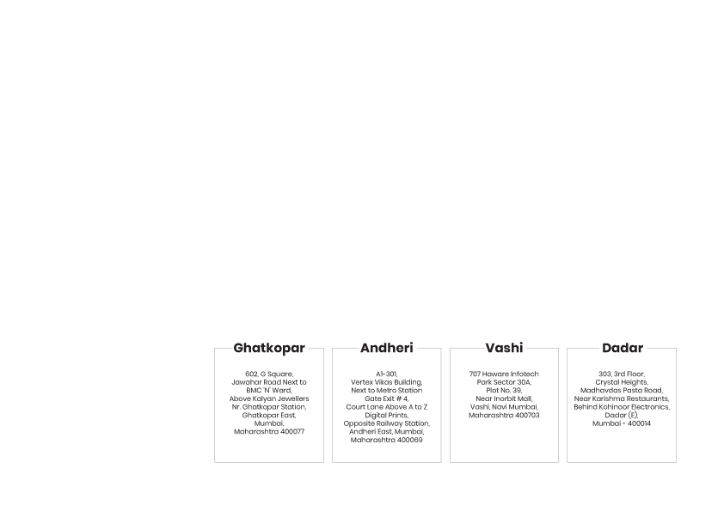
BE AN EXPERT DATA SCIENTIST!
www.mcta.co.in

